Slide 1
INTRODUCTION TO ANAEMIAS
MLS 332

Slide 2
Introduction
Definition of Anaemia
Anaemia is a decrease in the RBC count, Hgb and/or HCT values as compared to normal reference range for age, altitude and gender
When the amount of Hb in an individual cannot sustain the physiological activities in their system
True anaemia:
decreased RBC mass and normal plasma volume
Pseudo or dilutional anaemia:
normal RBC mass and increased plasma volume
An increase in plasma volume can occur in Pregnancy, fluid volume overload (IVs) congestive heart failure
Low Hgb and HCT values
Notes:
Blood volume = RBC mass + plasma volume
An increase in plasma volume may cause a dilutional or pseudo anemia (with low Hgb & HCT values) even though the RBC mass is normal ....can occur during pregnancy or caused by volume overload (IVs), congestive heart failure.
IV=intravenous fluid

Slide 3
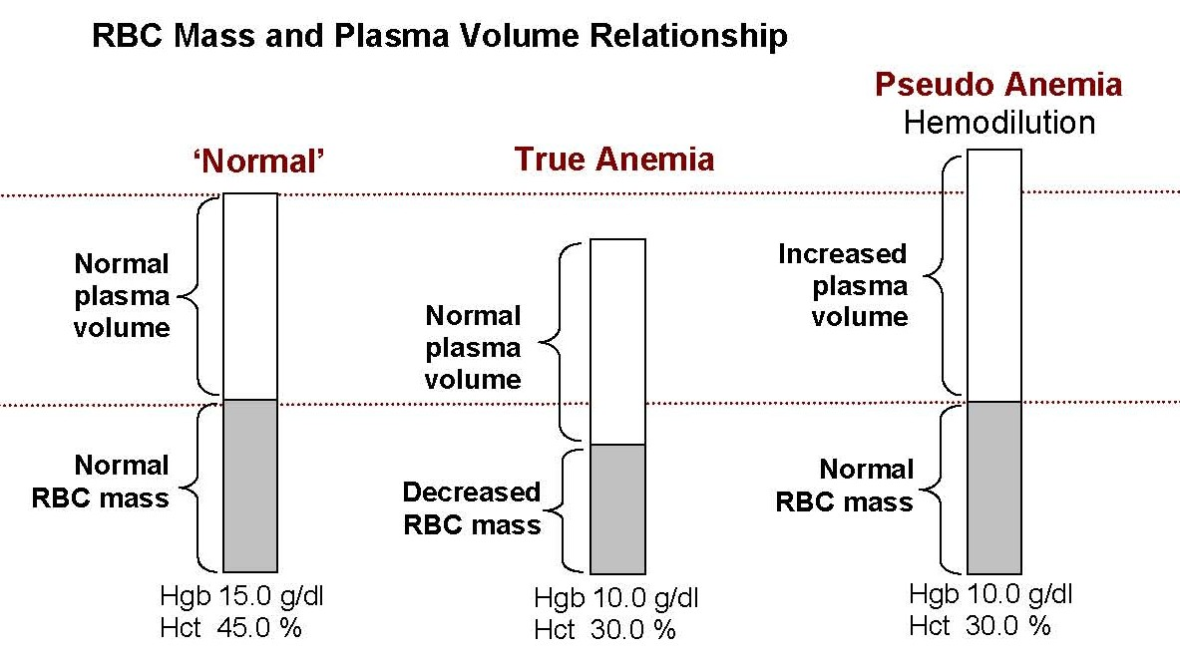
Definition of Anaemia cont’d
Notes:
Discuss relationship of RBC mass and plasma volume in differentiating true from pseudo anemia.
Reference: Wintrobe

Slide 4
Anaemia definition cont’d
Clinical diagnosis of anaemia is made by:
patient history
physical exam
signs and symptoms
laboratory findings
This definition emphasizes the differences one should expect when evaluating probable anaemia in the different age groups
Anaemia must also relate to the level of haemoglobin the individual normally possesses
If an adult male usually maintains a haemoglobin level of 16g/dl, and over a period of days is noted to have decreased to 14g/dl, this must be considered significant even though both values are within the normal range for an adult male.
Notes:
Instructor note: Explain why you are giving them 2 different definitions of anemia and the importance of both definitions
Functionally anemia is defined as tissue hypoxia (inability of the body to supply tissue with adequate oxygen for proper metabolic function)

Slide 5
Signs of Accelerated Bone Marrow Erythropoiesis
Due to hypoxia, the kidney will produce erythropoietin, which plays a major role in stimulating RBC production in the bone marrow
The marrow becomes hypercellular due to a marked increase in RBC precursors (called erythroid hyperplasia) and the M:E ratio falls.
Nucleated RBCs may be released into the blood circulation along with the outpouring of reticulocytes
nRBC number tends to correlate with the severity of anaemia
Increased polychromasia on the Wright's- stained blood smear is seen due to increased number of circulating reticulocytes

Slide 6
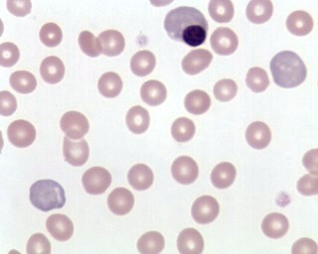
Signs of Accelerated Bone Marrow Erythropoiesis
NRBC
Polychromasia
Wright’s stained blood smear
Notes:
Reference: Dacie and Lewis

Slide 7
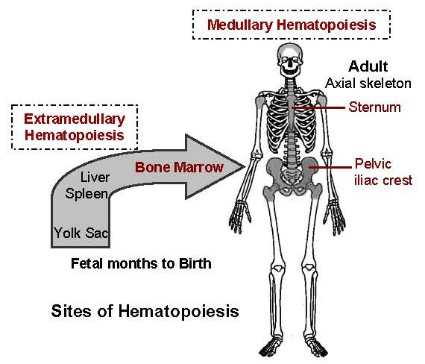
Medullary and Extra Medullary Hematopoeisis
If demand exceeds maximal bone marrow activity, RBC production may occur in extramedullary sites, liver, spleen (hepatosplenomegaly).
Notes:
Reference: Williams

Slide 8
Physiologic Response to Anaemia
Ability to adapt to anaemia depends on:
Age and cardio/pulmonary function
Rate at which anaemia develops (BM can compensate easier if the onset of anemia is slow),
Underlying disease
Symptoms of hypoxia: decreased oxygen delivery to the tissues/organs causes:
fatigue, faintness, weakness, dizziness, headaches, dyspnea, poor exercise tolerance, leg cramps.
Notes:
Physiologic response to anemia: the patient's ability to adapt to the hypoxia of anemia will depend on their age,cardio/pulmonary function, the rate the anemia has developed (can compensate easier if slow onset), and underlying disease.
1. Symptoms - decreased oxygen delivery to the tissues/organs causes fatigue, faintness, weakness, dizziness, headaches, dyspnea, poor exercise tolerance, leg cramps. Physical findings - pallor, rapid pulse, neurologic problems…see table.

Slide 9
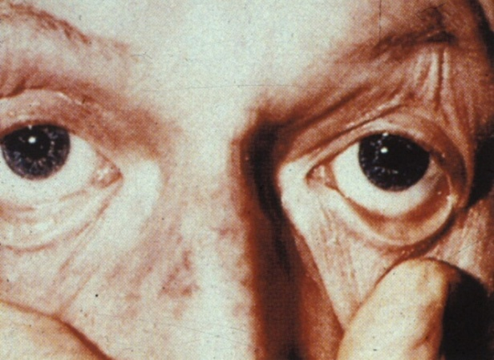
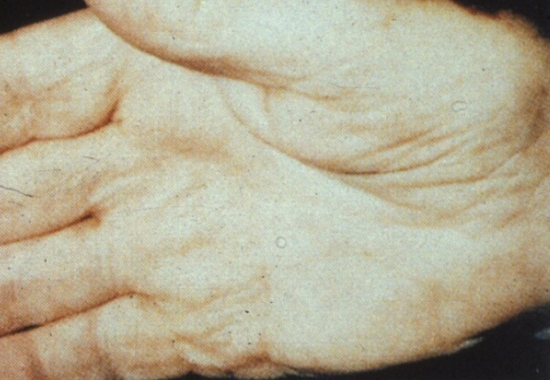
Symptoms cont’d
Pallor
General physical findings:
Pallor, rapid pulse, neurologic problems
Notes:
Reference: Wintrobe

Slide 10
Methods of Anaemia Classification
Different schemes of classifying anemias exist:
Morphologic
Based on RBC morphology and RBC indices
Anaemia is divided into three groups
Pathophysiologic
Anaemia is based on causes/mechanisms
Impaired erythrocyte formation (aplastic anemia, IDA, sideroblastic anemia, anemia of chronic diseases, megaloblastic anemia)
RBC loss (GI bleed) and destruction (hemolysis)
Notes:
Anemia classification - No "perfect" classification method so a combination is used.
A. Morphologic ‑ anemias are divided into three groups on the basis of the MCV....uses the RBC indices (RBC size & haemoglobin content).
B. Etiologic ‑ anemias are divided using two main causes/mechanisms.
Two general mechanisms are involved in anemia states:
1. Decreased delivery of red cells to the circulation:
■Anemias due to defective maturation or decreased production.
This group of anemias generally have inappropriately low retic counts → the bone
marrow fails to respond appropriately due to injury, replacement, or lack of essential
haematopoietic factors (such as iron or folic acid).
2. Increased loss of red cells from the circulation:
■Anemias due to acute bleeding or accelerated destruction.
This group of anemias usually have high retic counts → the bone marrow can respond
and haematopoietic factors are sufficient. Anemia in this group results when red cell loss exceeds the bone marrow's capacity to increase its activity.
Note: If bone marrow compensation is adequate, anemia does not develop.

Slide 11
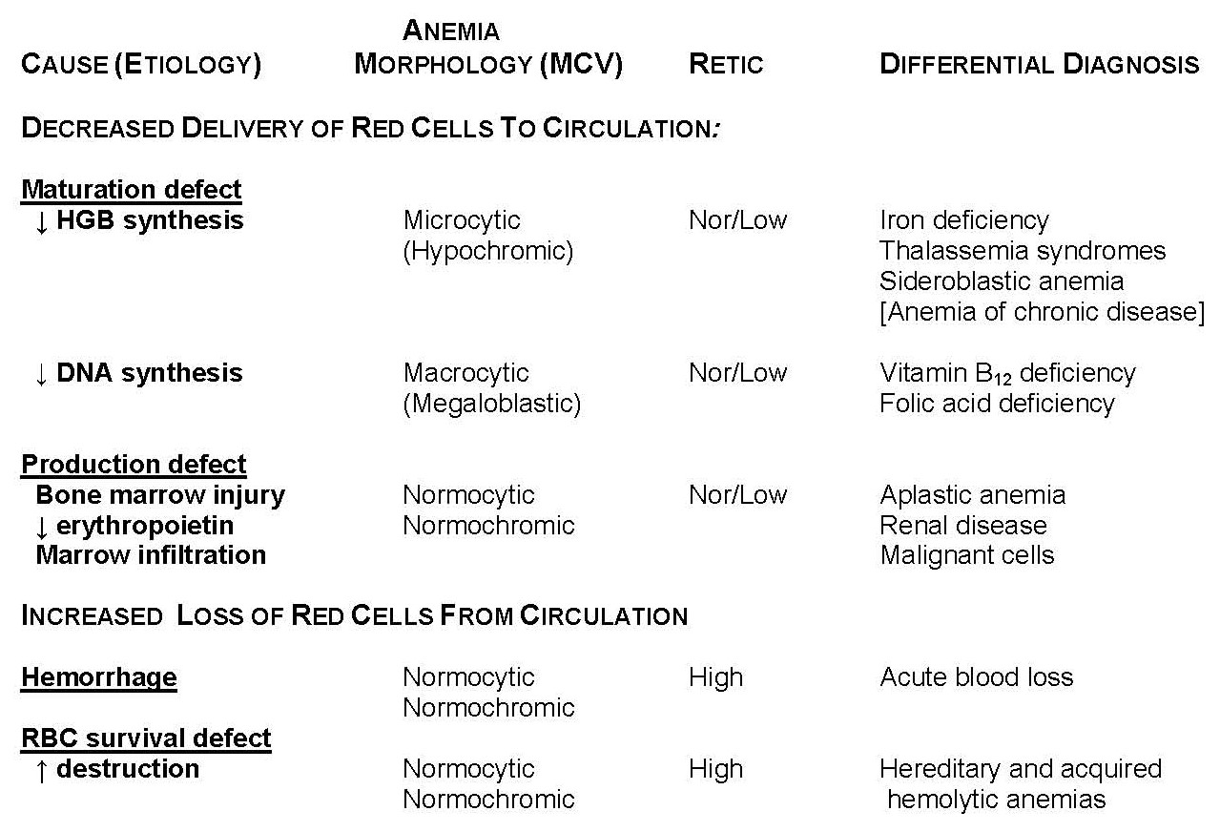
Classification of Anaemia
Notes:
Anemia of chronic disease may be microcytic or normocytic
Reference: Dacie and Lewis

Slide 12
Methods of Classification cont’d
Increased blood loss (Acute, Chronic)
Retic count is typically high
Anemia results when red cell loss exceeds the bone marrow’s capacity to increase its activity
Increased destruction of RBCs (hemolytic anemias)
Retic count is typically high
Anemia results when red cell destruction exceeds the bone marrow’s capacity to increase its activity

Slide 13
Morphologic Categories of Anaemia
Originally proposed by Dr. Wintrobe, a morphologic classification is based on how the cells appear on a stained smear and should correspond with the red cell indices.
Normocytic Normochromic (NCNC): anaemia due to decrease in the number of erythrocytes
(e.g. aplastic anemia, or acute blood loss)
Microcytic hypochromic
Macrocytic Normochromic
Notes:
Reference: Wintrobe

Slide 14
Morphologic Categories of Anaemia cont’d
Microcytic Hypochromic, anaemia
low MCHC
low MCV
Examples:
iron deficiency anaemia
sideroblastic anaemia
Thalassemias
anemia of chronic disease (rare cases)

Slide 15
Morphologic Categories of Anaemia cont’d
Macrocytic Normochromic anaemia
normal MCHC
high MCV
Examples:
Vitamin B12 deficiency
Folic Acid deficiency
Liver disease
Notes:
Limitation: the morphologic classification does not tell the cause of anemia

Slide 16
Morphologic Categories of Anaemia cont’d
Normocytic Normochromic (NCNC) anaemia
normal MCV
normal MCHC
Examples:
anaemia of acute haemorrhage
aplastic anaemias (those characterized by disappearance of RBC precursors from the marrow)
anaemias of chronic disease (ACD)
haemolytic anaemias (those characterized by accelerated destruction of RBC’s)
Notes:
Instructor note: tell students that several ways of classification exist and we will be following the morphologic classification of anemias

Slide 17
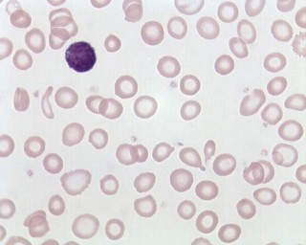
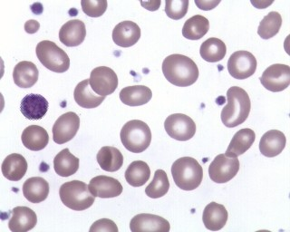
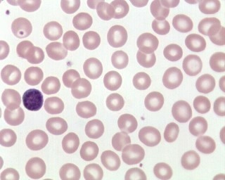
Morphologic Categories of Anaemia
1
1 Microcytic/hypochromic
2
2 Macrocytic/normochromic
N.B. The nucleus of a small lymphocyte (shown by the arrow) is used as a reference to a normal red cell size
3
3 Normocytic/normochromic
Notes:
Instructor note: Identify and discuss the blood picture in each of the morphologic classifications of anemia. Answers appears upon click if in Slide Show mode.
Reference: Dacie
The nucleus of a small lymphocyte,
which has a diameter of approximately 8.5 μm, is a
useful guide to the size of a red cell

Slide 18
Microcytic Hypochromic Anaemias
Evaluate the laboratory findings associated with microcytic/hypochromic anaemias based on etiology, blood and bone marrow findings, and tests used to aid in diagnosis
Iron deficiency anaemia
Sideroblastic anaemias (primary and secondary types)
Anaemia of chronic disease
Alpha and beta thalassemias (major and minor types)

Slide 19
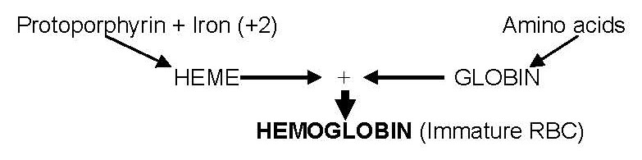
Microcytic/Hypochromic Anaemias
Characterized by impaired haemoglobin synthesis
Sideroblastic anaemia
IDA
ACD
Thalassaemia (α orβ)
Abbott Manual
Notes:
Blocks in Hgb synthesis; normoblastic RBC maturation (all supplies available) results in normocytic rbcs versus lack of a hgb building block that results in microcytic rbcs Decrease in Hgb synthesis
Deficiency in heme synthesis
Iron deficiency (IDA)
Iron is trapped within macrophages and is unavailable for heme synthesis (ACD)
Failure of protoporpyirin synthesis (Sideroblastic anemia)
abnormal metabolism within the RBC itself. In this case, iron is sequestered in the developing RBC mitochondria and is unavailable for heme synthesis (e.g. sideroblastic anemia)
Deficiency in globin chain synthesis (α or β Thalassemias)
Reference: Williams

Slide 20
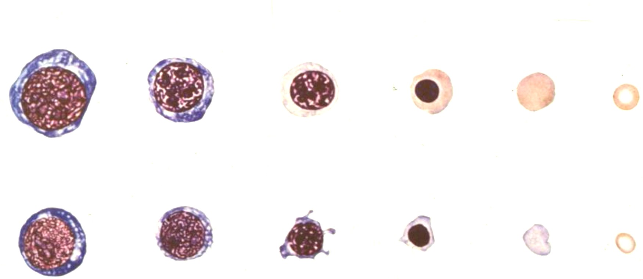
Microcytic/Hypochromic Anaemias
Normoblastic RBC maturation → normocytic red cells
RBC maturation in microcytic anemias
Abbott Manual
Notes:
Normal RBC maturation is shown for comparison
Reference: Williams

